Slide 1
Florida Civics End of Course Exam Preparation & Strategies
Helpful Hints and Tips to Perform Successfully on your Civics EOC Test Day!
You’re AWESOME and You Know It!

Slide 2
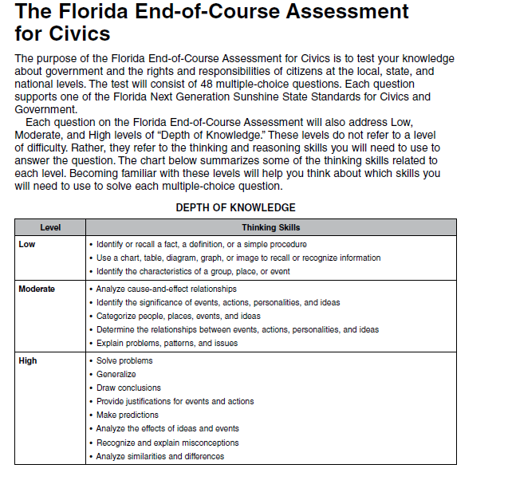
Levels of Questions
Low – fact recall
Moderate– analyze
or explain
High – apply what
you know

Slide 3
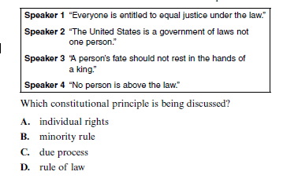
Multiple Choice Questions
Sample Question
How can I choose the best answer?
All of the questions on your EOC will be multiple choice. There will be 48 questions total.
There will be four answer options for you to choose from.
Read the question carefully.
Read through each of the answer choices; mark through any that you know are definitely NOT the correct answer.
Watch out for words like “always” or “never” – those usually are a clue that can be distracting…

Slide 4
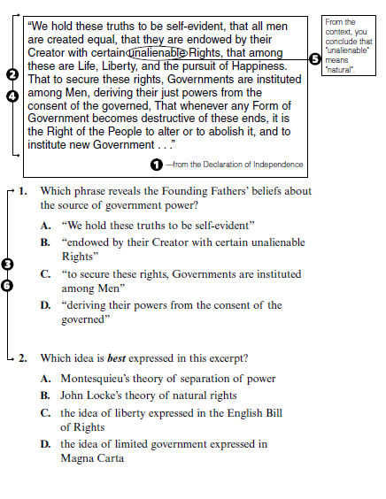
Primary Sources
What is a primary source?
Sample Question
Materials that have been written or made by people who were at historical events, either as observers or participants. Primary sources include journals, diaries, letters, speeches, newspaper articles, autobiographies, laws, wills, and financial records.
Most primary sources will be in “quotes” on the EOC.
Be sure to read each quotation carefully and entirely.
Re-read any section that might be unclear and search for context clues to find meaning.
Use your multiple choice skills to help you choose the best answer.

Slide 5
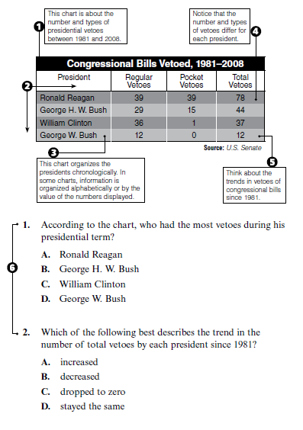
Charts
What types of charts will I see on my EOC?
Sample Question
Your EOC will consist of several graphics – some examples are: tables, flow charts and Venn diagrams.
Be sure to read all of the information on the graphic to collect the details necessary to answer the question.
Try to draw conclusions or make connections based on what you KNOW and what you are SEEING in the chart/graphic.
Use your multiple choice skills to help you choose the best answer.

Slide 6
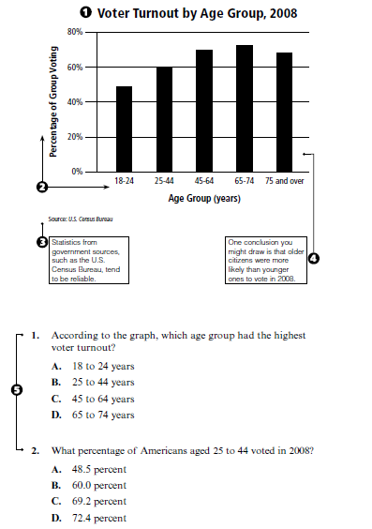
Graphs
Sample Question
What kind of graphs will I see on my EOC?
You may see line graphs or bar graphs on your EOC.
Graphs help you make distinctions, or comparisons, about a set of data.
Read the labels on the graphs to make sure you know what you’re looking at!
Draw conclusions and make connections based on what you KNOW and what are you are SEEING in the graph.
Use your multiple choice skills to help you choose the best answer.

Slide 7
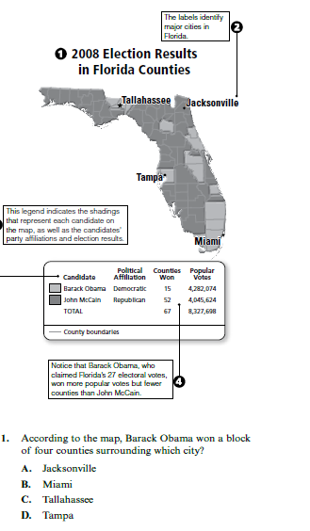
Maps
Sample Question
Will I have to read maps on my EOC?
There is a possibility that you can see a map or two on your EOC.
There are three kinds of maps: political, physical, and thematic.
Be sure to the read the title of the map.
Read the map key so you know what the symbols mean.
Draw conclusions and make connects based on what you KNOW and what you are SEEING on the map.

